Slide 1
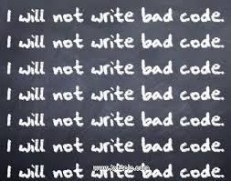
Bad Code ? No thanks !
By Georgi Genov
CONFIDENTIAL | © 2019 EPAM Systems, Inc.

Slide 2

About me
Developing for 8 years now
Expertise in PHP / JS / Mobile hybrid apps
Like playing football and volleyball
http://www.ggenov.eu

Slide 3

The good old coding principles
CONFIDENTIAL | © 2019 EPAM Systems, Inc.

Slide 4

You Aren’t Gonna Need It
When we will have to do validation of email and password field, we shouldn’t do validation of post code, because we may never need it.
CONFIDENTIAL | © 2019 EPAM Systems, Inc.

Slide 5
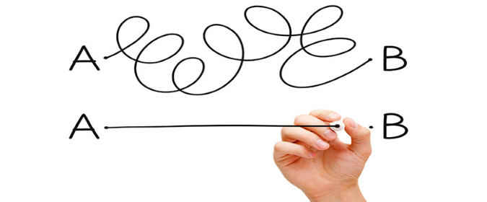
Keep It Simple, Stupid
You want a picture, you buy a picture. You don’t buy white canvas, colors and start drawing…
CONFIDENTIAL | © 2019 EPAM Systems, Inc.

Slide 6
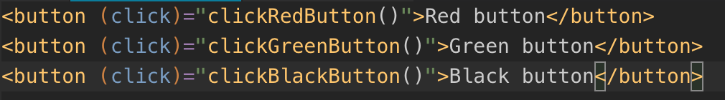
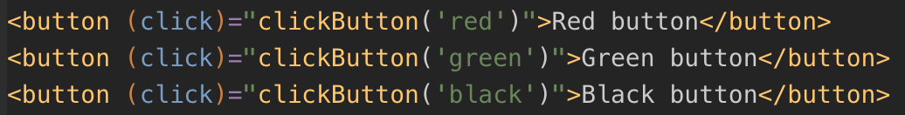
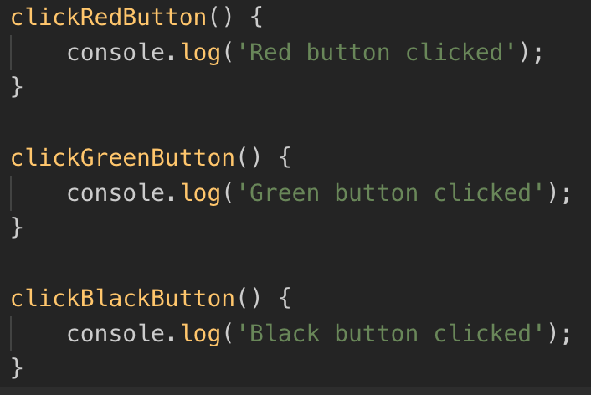
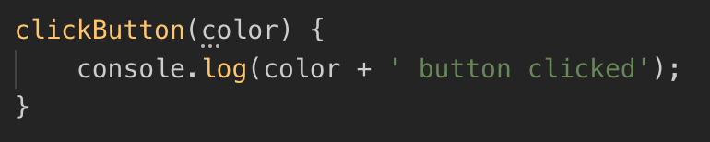


Don’t Repeat Yourself
CONFIDENTIAL | © 2019 EPAM Systems, Inc.

Slide 7
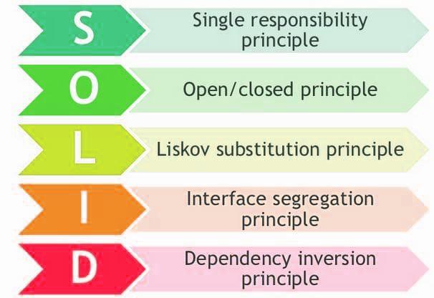
SOLID
CONFIDENTIAL | © 2019 EPAM Systems, Inc.

Slide 8
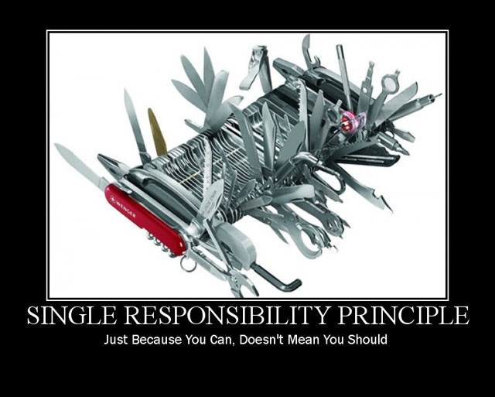
Single responsibility
A class should have only a single responsibility.
CONFIDENTIAL | © 2019 EPAM Systems, Inc.

Slide 9
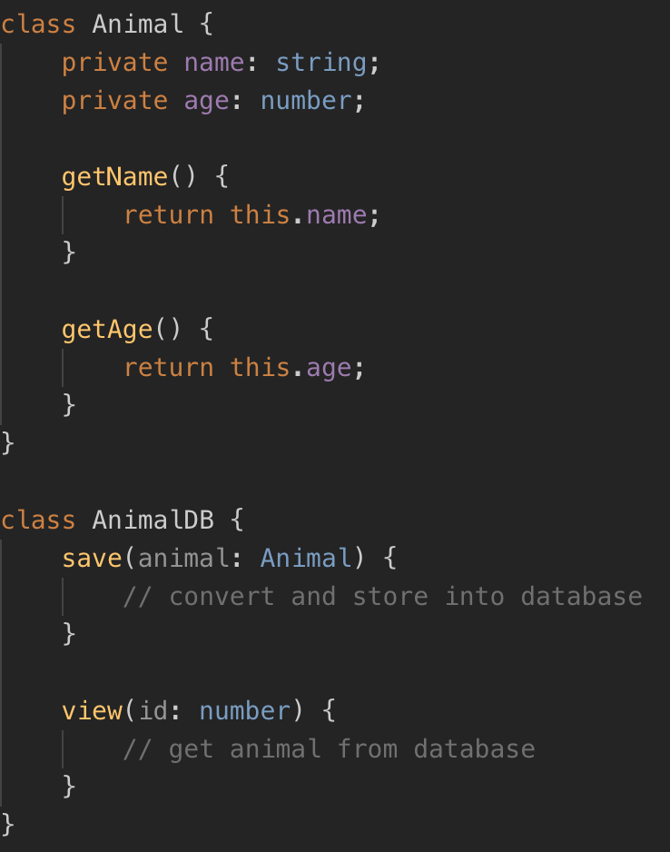
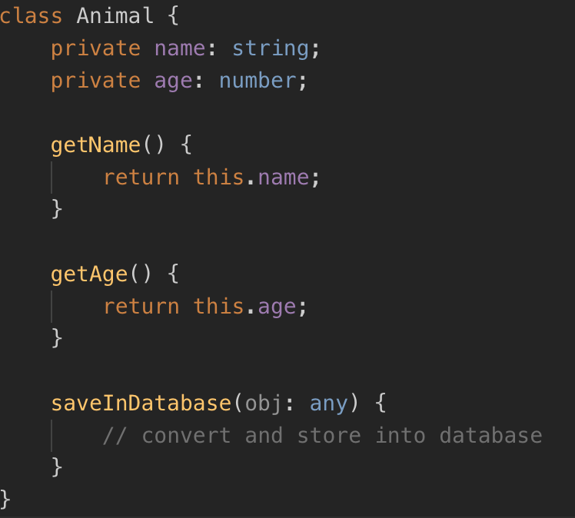
Single responsibility
CONFIDENTIAL | © 2019 EPAM Systems, Inc.

Slide 10
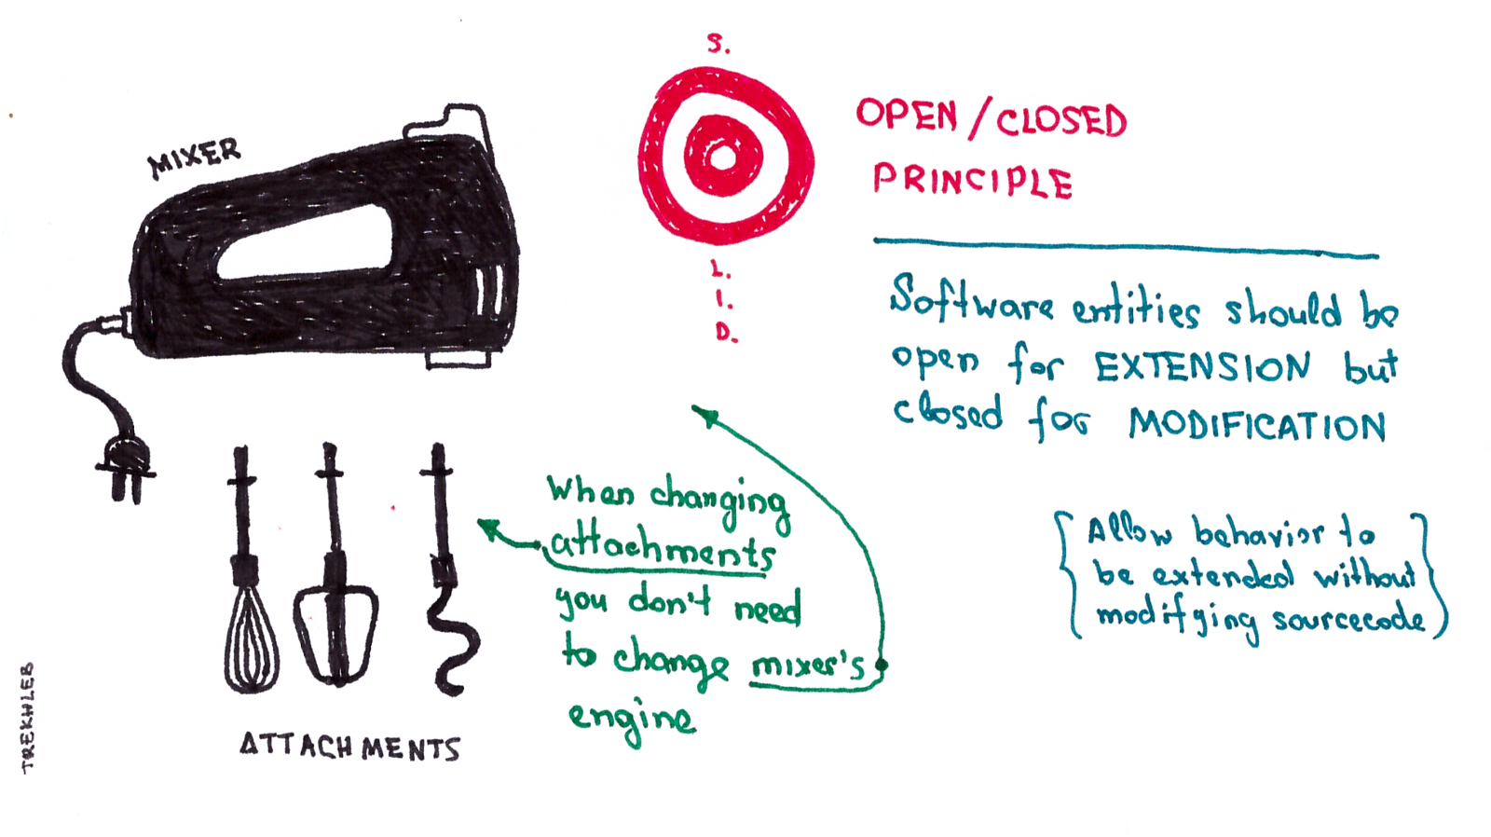
Open-closed
"Software entities ... should be open for extension, but closed for modification.”
CONFIDENTIAL | © 2019 EPAM Systems, Inc.

Slide 11
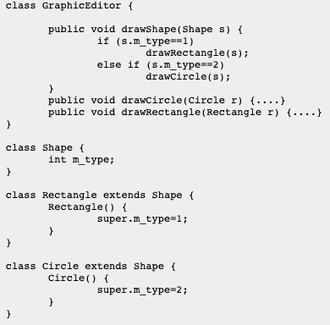
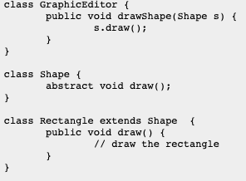
Open-closed
CONFIDENTIAL | © 2019 EPAM Systems, Inc.

Slide 12
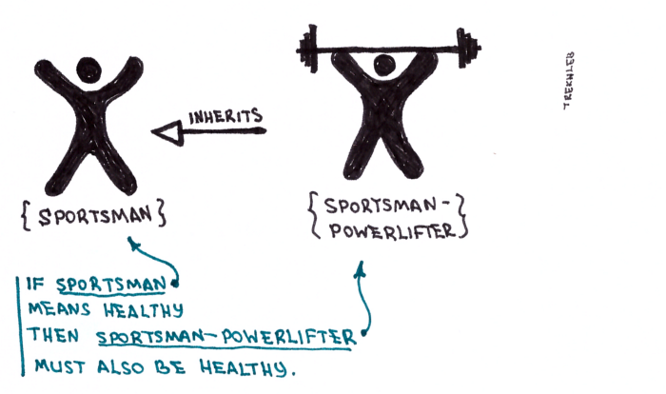
Liskov substitution
"Objects in a program should be replaceable with instances of their subtypes without altering the correctness of that program.”
CONFIDENTIAL | © 2019 EPAM Systems, Inc.

Slide 13
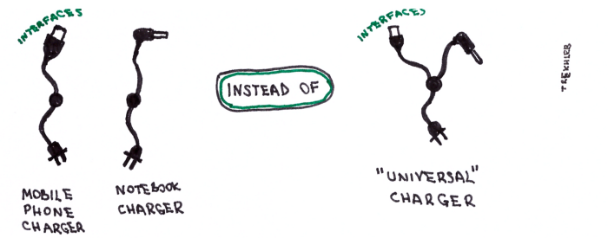
Interface segregation
Code should not be forced to depend on methods that it doesn’t use
CONFIDENTIAL | © 2019 EPAM Systems, Inc.

Slide 14
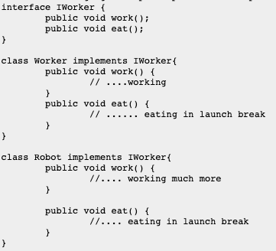
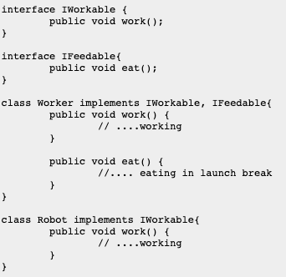
Interface segregation
CONFIDENTIAL | © 2019 EPAM Systems, Inc.

Slide 15

Dependency inversion
One should "depend upon abstractions, [not] concretions."
CONFIDENTIAL | © 2019 EPAM Systems, Inc.

Slide 16
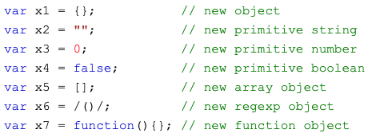
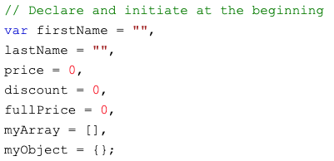
Few hints
Avoid Global Variables, use local ones instead
Minimize the use of global variables. Global variables and functions can be overwritten by other scripts. Use local variables instead defined with “let”. Strict mode does not allow undeclared variables.
Initialize Variables
It is a good coding practice to initialize variables when you declare them.
Don't Use new Object()
Use {} instead of new Object()
Use "" instead of new String()
Use 0 instead of new Number()
Use false instead of new Boolean()
Use [] instead of new Array()
Use /()/ instead of new RegExp()
Use function (){} instead of new Function()
CONFIDENTIAL | © 2019 EPAM Systems, Inc.

Slide 17
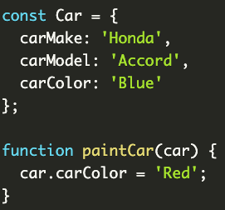


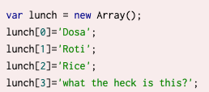
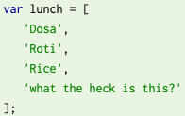
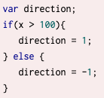
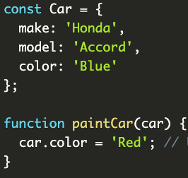
Common mistakes
CONFIDENTIAL | © 2019 EPAM Systems, Inc.

Slide 18
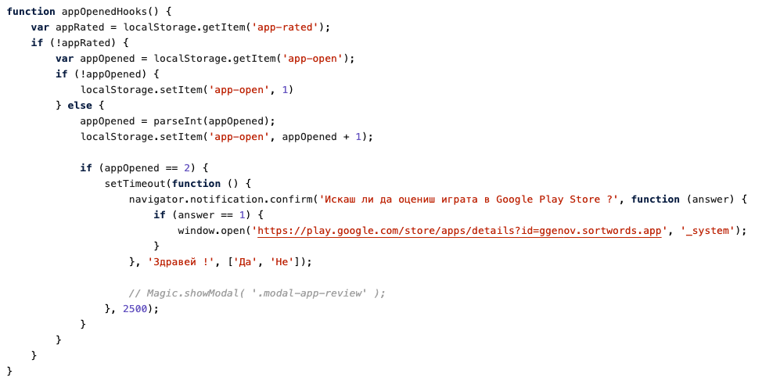
Bad code example #1
CONFIDENTIAL | © 2019 EPAM Systems, Inc.

Slide 19
Bad code example #1
CONFIDENTIAL | © 2019 EPAM Systems, Inc.

Slide 20
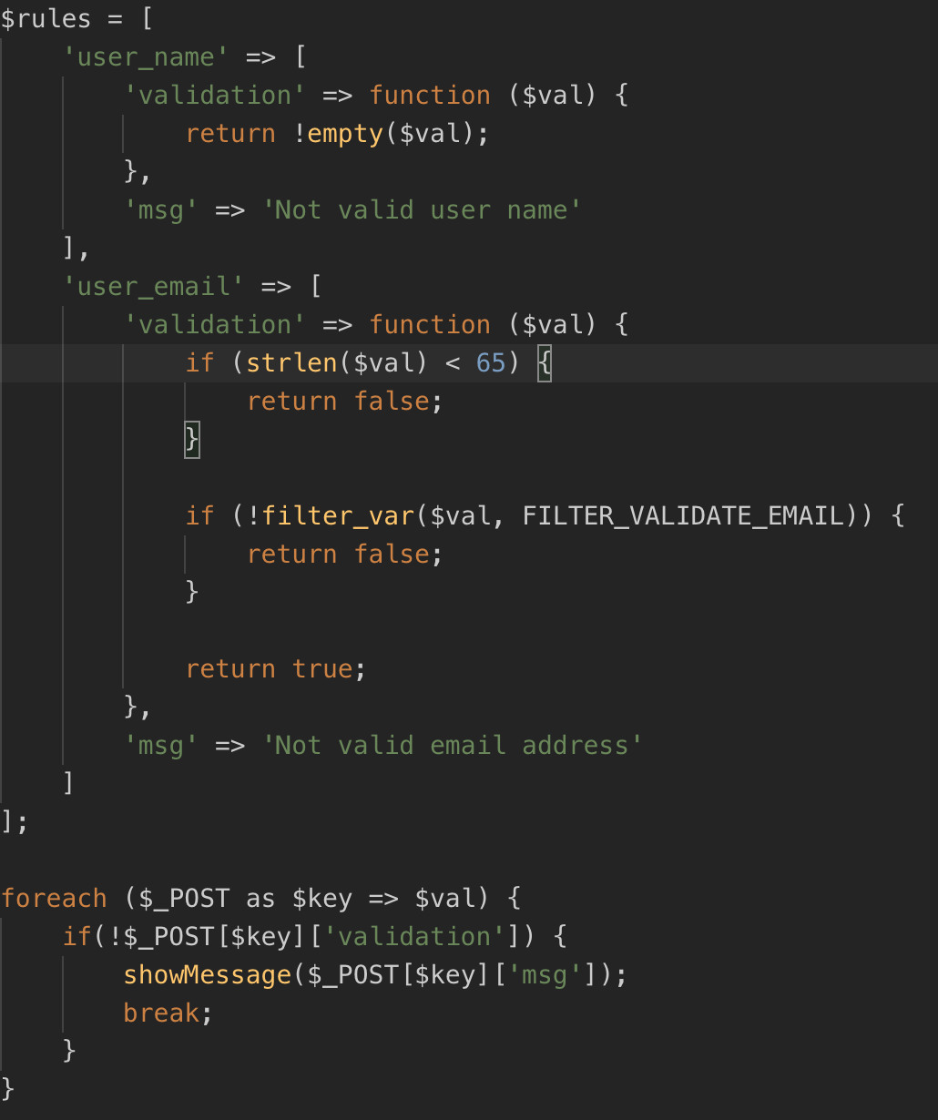
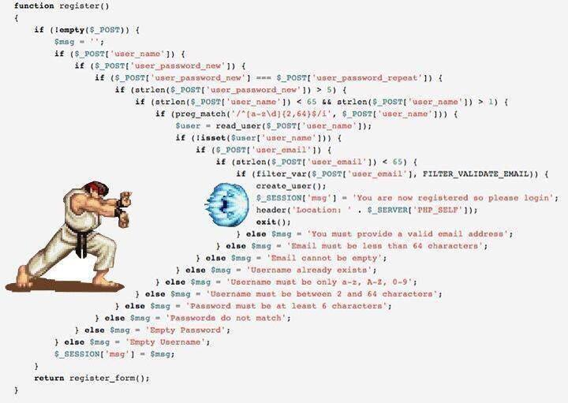
Bad code example #2
CONFIDENTIAL | © 2019 EPAM Systems, Inc.

Slide 21
Way too bad code examples
https://bitbucket.org/ggenov91/math-school-app/src/master/www/js/magic.js
https://bitbucket.org/ggenov91/find-me-app/src/master/www/js/services.js - Api
https://bitbucket.org/ggenov91/select-word-app/src/master/src/app/pages/word/word.ts - selectLetter
https://bitbucket.org/ggenov91/famestand-new/src/master/app/Libraries/Magic.php - getUserNotifcationsQuery
CONFIDENTIAL | © 2019 EPAM Systems, Inc.

Slide 22
Thank you ! Questions ?

